Slide 1
Responding to How People Learn
Associate Provost Linda Eads
Panel: Patty Wisian-Neilson, Dedman College
Miguel Quiñones, Cox School of Business
Maria Dixon, Meadows School of the Arts
Stephanie Al Otaiba, Simmons School of Education and Human Development

Slide 2
Agenda: Note this is just for us speakers
65 mins
Linda 5 min intro
Me 5-min to set stage, model one engagement strategies- e.g., ticket out the door, and introduce panel?
Linda, Mickie, Maria and Patty panelists talk for 5-10 mins
Questions/discussion: Priority here
Ticket out the Door: Set intention
Raffle/Prize- I have two copies of the engagement book on order

Slide 3
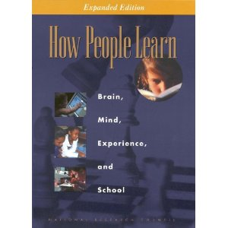
SMU is a community-centered environment with collective norms that value learning and high standards
Responding to the research base to keep our teaching relevant
  How does learning change the brain?
  How do we use formative assessment to support learning and inform problem solving?
  How do we use technology “smarter” to engage students?
  How can we make classroom learning relevant and motivating?
Notes:
An extensive research base National Research Council and How people learn
There is a science behind adult learning and findings converge across: developmental psych, cognitive psych, neuroscience, and education.
Make case that apply across fields as exemplified by panelists

Slide 4
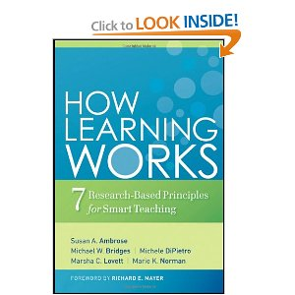
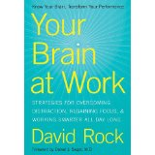
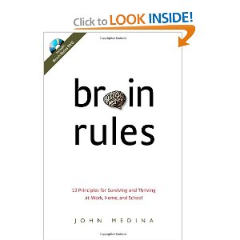
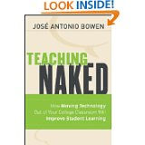
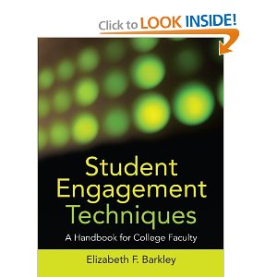
More Sources
Notes:
An extensive research base National Research Council and How people learn
There is a science behind adult learning and findings converge across: developmental psych, cognitive psych, neuroscience, and education.
Make case that apply across fields as exemplified by panelists

Slide 5
How Learning Works:
7 Research-Based Principles for Smart Teaching
Linda Eads:
1. Students' prior knowledge can help or hinder learning.
2. Students' current level of development interacts with the social, emotional, and intellectual climate of the course to impact learning.
Mickey Quiñones :
3. How students organize knowledge influences how they learn and apply what they know.
4. Students' motivation determines, directs, and sustains what they do to learn.

Slide 6
Maria Dixon and Patty Wisian-Neilson
5. To develop mastery, students must acquire component skills, practice integrating them, and know when to apply what they have learned.
6. Goal-directed practice coupled with targeted feedback enhances the quality of students' learning.
7. To become self-directed learners, students must learn to monitor and adjust their approaches to learning.

Slide 7
Linda Eads

Slide 8
Prior Knowledge
Rule of Primacy—remember best what we learn first
Line-up Identification– once a suspect is identified, witness becomes more sure as time goes by– Innocence Project
Remembering events– Kennedy Assassination and Oral History
Belief in late 19th century that we did not have much more to discover in physics
How old is the Earth?
Newton and the Static Universe

Slide 9
What To Do With Prior Knowledge
Use to advantage as teachers– more class room engagement, contribution encouraged, more learning
Convert Rule of Primacy to Rule of Recency– Remember longest what you learn last
Respect the individual with incorrect knowledge—can respect the person without respecting the idea
Let it challenge your assumptions at first quietly and then, if your assumption changed, with disclosure—Daly story

Slide 10
Human Cognition
Two Different Tracks:
Automatic, instinctive reactions
Reflective, deliberative
Automatic, instinctive reactions very dependent on:
Nonverbal signals and behaviors
Individual reactions to such signals and behavior
Important point when we tie it to bias issues

Slide 11
Various Studies Indicate Effect on Learning
Dr. Fox Study– distinguished looking but meaningless lecture
Thin Slice Research– opinions reached quickly and unchanged over length of course
University of Georgia study– racial bias led to less learning
Gender bias in list of desirable faculty traits
Gender bias in assumptions made on level of accomplishment
Consider how these studies could affect the level of learning in a classroom– particularly if the course content is difficult or full of hot-button issues

Slide 12
Mickey Quinones

Slide 13
How students organize knowledge influences how they learn and apply what they know.
Advanced organizers or concept maps
Match categorization scheme to the task
Expertise differences in structures
  Novice – Sparse, less interconnected
  Expert – Dense, more interconnected
Surface versus deep level features

Slide 14
The Broken Light Bulb
In a physics lab at a major university, a very expensive light bulb which could emit precisely controlled quantities of light was being used in some experiments. Ruth was the research assistant responsible for operating the sensitive light bulb. One morning she came into the lab and found to her dismay that the light bulb no longer worked. She realized that she had forgotten to turn it off the previous night. As a result the light bulb overheated, and the filament inside the bulb had broken into two parts. The surrounding glass bulb was completely sealed, so there was no way to open it. Ruth knew that the light bulb could be repaired if a brief, high intensity laser beam could be used to fuse the two parts of the filament into one. Furthermore, the lab had the necessary equipment to do the job. However, a high intensity laser beam would also break the fragile glass surrounding the filament. At lower intensities the laser would not break the glass, but neither would it fuse the filament. So it seemed that the light bulb could not be repaired, and a costly replacement would be required.
Can you help Ruth fix her lightbulb?

Slide 15
The Tale of Sir-Smells-A-Lot
During the time of King Arthur, a bloody rebellion was planned to overthrow the King. A young chap named Sir Smells-a-lot organized a sizable army and trained them for several months. Sir Smells-a-lot planned to use his army to storm the King’s castle and overcome the outnumbered defense army inside. The day of the siege came and Sir Smells-a-lot marched his army toward the castle. His plan could only succeed if he was able to get his entire army to the castle walls at once so he could overwhelm the resistance. Upon reaching the castle, Sir Smells-a-lot noticed that the main bridge to the castle was up. They tried using one of their ladders to get the army across but it quickly became apparent that it would not be strong enough to get the entire army across the moat in the time required. Sir Smells-a-lot was in a bind.
How was he going to get his army across the moat in time to overwhelm the resistance?

Slide 16
Students' motivation determines, directs, and sustains what they do to learn.
Link to something they care about – relevance (value)
Understand possible goals being pursued – tap into multiple goals
  Examples, getting a job, starting a business, moving up in the organization, getting good grades
  Show relevance to these goals – current and future ones
Expectations
  Outcome expectancies – This will work
  Efficacy expectancies – I can do this
Environmental support

Slide 17
Maria Dixon

Slide 18
To develop mastery…
mastery
Component
Skills
Integrative
Practice
Timing of Application

Slide 19
“What do I want them to be able to DO?”
A question that moves learning beyond repetition of facts and memorization
A question that moves application and problem solving to the forefront
A question that assumes that knowledge is gained for utilization in multiple contexts

Slide 20
A Lesson from the Master Chef
Seasonings and sauces
What are the properties of salt, sugar, Pepper, citrus, carbonation, oils, and 5 key herbs
Meats, Grains, and Veggies
Steaks, Briskets, Chops, Turkey, Hens, Hams, Shrimp, and Salmon; Roots, Leaves, Rice, Cereal, Bread, and Potatoes
Temperature and Methods
Pans, Pots, Grills, and Ovens

Slide 21
A Lesson from the Master Chef
Learn the building blocks
Learn and Understand key Concepts
Assess the ingredients and cooking conditions
Contextual Understanding
Prepare the meal
Fluent Retrieval

Slide 22
“Give me a dollar”
Audience Analysis
Issue Framing
Message Creation and Analysis
“Tracing the Masters”
“What did they do wrong?
“Give me a Dollar”

Slide 23
Patty Wisian-Neilson

Slide 24
To develop mastery,
students must acquire component skills
  http://faculty.smu.edu/pwisian/Chem1303/chem1303.htm
  http://faculty.smu.edu/pwisian/Chem1303/Chapter10.pdf
practice integrating them
  http://faculty.smu.edu/pwisian/Chem1303/Homework.htm
know when to apply what they have learned

Slide 25
Goal-directed efficient practice coupled with targeted (immediate) feedback enhances the quality of students' learning.
Learning is active. Do the problems!
Answers to all problems must always be available immediately.
Exams and quizzes always returned the next class period.
Office hours for answering questions, but mostly for encouraging and building confidence.
Discussion Board - http://www.neilsonchem.com/cgi-bin/discus/discus.cgi

Slide 26
Students must learn to monitor and adjust their approaches.
The first test did not go very well, but the issue was not that I did not know or understand what was on the exam. A majority of the problems that I got wrong, were things I knew and I thought I put down on the test. I had a lot of silly mistakes. I do have an issue with testing anxiety as well but, I think my main issue this time was speed and accuracy. I went to your office hours, I did the problems twice, and I did problems from the practice test twice. My plan as of now is to make sure I have a clear understanding of the material by doing and redoing the problems twice, and after establishing a clear understanding of the information we will be tested on, I'll redo the problems a third time focusing on speed and accuracy by timing myself when I redo the problems.
Do you have any advice on how I can avoid a repeat of my last test?

Slide 27
Students must learn to monitor and adjust their approaches.
General advice given to my students:
Do the homework! Do the homework! Do the homework!
It's OK to do homework in the daylight!
Learning is private. Tutors, ALEC, friends are helpful on rare occasion, but things have to click in the student's own mind and that happens when he/she works alone. Figure it out yourself and you never forget!
Don't read the book! It's not a novel. Two hours of reading is inefficient. Read after tackling a problem and finding one that you can't do. Then read that section with a question in your mind.
Don't copy the problems and don't waste time making notecards. Do the homework!
Get enough SLEEP !

Slide 28
Your “Ticket Out the Door”:
Set your Mindful Intention
Three things I learned
One thing I will try
Here’s my intention

Slide 29
Lucky numbers

